Slide 1




Heightened
Reliance on
Automation and
Control Systems
Utilization of
Insecure External
Technologies with
Network
Known
Connectivity
Vulnerabilities
Contemporary
Control System
Absence of a
Limited Security in
Inadequate Security
Business Case for
Control System
in Communication
Cybersecurity
Technologies
Protocols
Architectures
Availability of Open
Source Information

Slide 2
Heightened
Reliance on
Automation and
Control Systems
Utilization of
Insecure External
Technologies with
Network
Known
Connectivity
Vulnerabilities
Contemporary
Control System
Absence of a
Limited Security in
Inadequate Security
Business Case for
Control System
in Communication
Cybersecurity
Technologies
Protocols
Architectures
Availability of Open
Source Information

Slide 3


Heightened
Reliance on
Automation and
Control Systems
Utilization of
Insecure External
Absence of a
Technologies with
Network
Business Case for
Known
Connectivity
Cybersecurity
Vulnerabilities
Inadequate
Limited Security in
Security in
Availability of Open
Control System
Communication
Source Information
Technologies
Protocols
Several driving factors contribute to the increase in security lapses or problems within control systems. One of the primary factors is the growing dependency on automation and control systems.

Slide 4
Heightened
Reliance on
Automation and
Control Systems
Insecure External
Network
Connectivity
Utilization of
Absence of a
Technologies with
Business Case for
Known
Cybersecurity
Vulnerabilities
Inadequate
Limited Security in
Security in
Availability of Open
Control System
Communication
Source Information
Technologies
Protocols
As control systems generate vast amounts of data, there is a desire to connect these systems with external networks to facilitate easier data access and derive valuable insights.

Slide 5
Heightened
Reliance on
Automation and
Control Systems
Insecure External
Network
Connectivity
Utilization of
Technologies with
Known
Vulnerabilities
Absence of a
Business Case for
Cybersecurity
Inadequate
Limited Security in
Security in
Availability of Open
Control System
Communication
Source Information
Technologies
Protocols
Control systems often become highly dependent on specific technologies, and even if vulnerabilities are discovered, it may be impractical to upgrade or replace these technologies.

Slide 6
Heightened
Reliance on
Automation and
Control Systems
Insecure External
Network
Connectivity
Utilization of
Technologies with
Known
Vulnerabilities
Absence of a
Business Case for
Cybersecurity
Inadequate
Limited Security in
Security in
Availability of Open
Control System
Communication
Source Information
Technologies
Protocols
Quantifying the tangible return on investment for cybersecurity measures can be challenging, which can discourage organizations from prioritizing security in control system implementations.

Slide 7
Heightened
Reliance on
Automation and
Control Systems
Insecure External
Network
Connectivity
Utilization of
Technologies with
Known
Vulnerabilities
Absence of a
Business Case for
Cybersecurity
Limited Security in
Control System
Technologies
Inadequate
Security in
Availability of Open
Communication
Source Information
Protocols
Control system technologies themselves may have limited built-in security capabilities. In some cases, the security capabilities provided by vendors are only enabled if the administrator is aware of their existence.

Slide 8
Heightened
Reliance on
Automation and
Control Systems
Insecure External
Network
Connectivity
Utilization of
Technologies with
Known
Vulnerabilities
Absence of a
Business Case for
Cybersecurity
Limited Security in
Control System
Technologies
Inadequate
Security in
Communication
Protocols
Availability of Open
Source Information
Many control system communication protocols lack built-in security functionality. For example, protocols like RS232 serial communication or OPCDA often do not support encryption or secure communication methods, making it challenging to add robust cybersecurity measures.

Slide 9
Heightened
Reliance on
Automation and
Control Systems
Insecure External
Network
Connectivity
Utilization of
Technologies with
Known
Vulnerabilities
Absence of a
Business Case for
Cybersecurity
Limited Security in
Control System
Technologies
Inadequate
Security in
Communication
Protocols
Availability of Open
Source Information
Another vulnerability stems from the considerable availability of open- source information regarding control system configuration and operation.

Slide 10
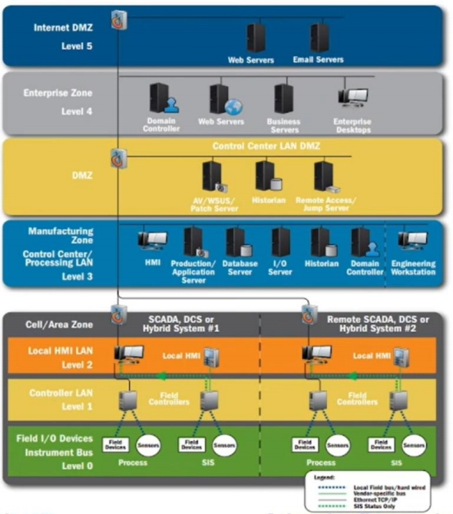
ICS Network Architectures
This architecture is referred
to as the integrated
architecture, and it adheres
to the Purdue model. This model provides insight into
the widely accepted
hierarchy of control systems.

Slide 11
ICS Network Architectures
The network comprises various levels, each designed to accommodate specific
functionalities and security controls:
1.Field Devices and Sensors (Level 0) 2.Controllers and Local HMI (Level 1) 3.Cell/Area/Zone (Level 2) 4.Manufacturing Control Center (Level 3) 5.DMZ (Demilitarized Zone
6.Enterprise Zone

Slide 12
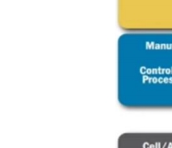
ICS Network Architectures
This standardized architecture enhances
security through segmentation and
controlled access. Understanding the architectural zones and aligning servers accordingly empowers organizations to design a robust and tailored cybersecurity strategy, safeguarding their ICS
environment effectively

Slide 13
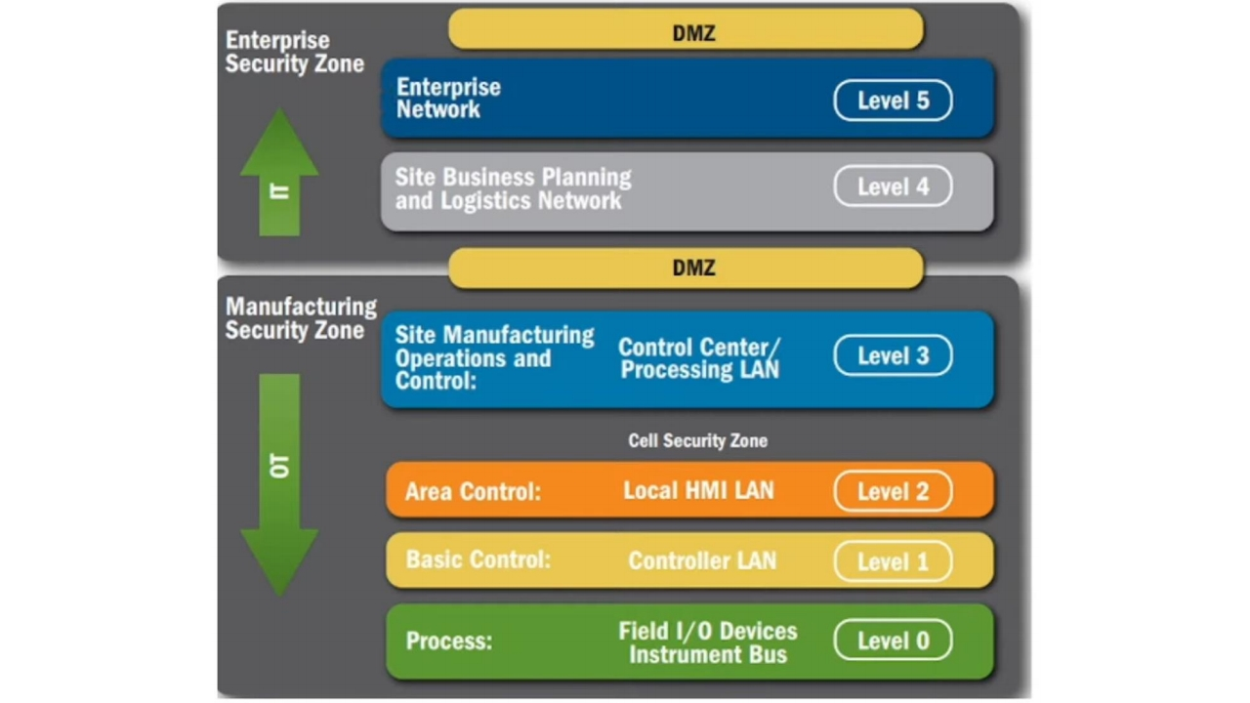

Slide 14
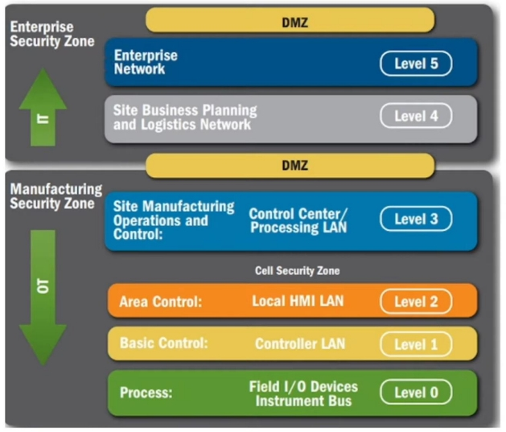
ICS Network Architectures
Achieving network segmentation is a critical step in defining these architectural zones. Let's explore the specific zones within this model:
1.Enterprise Security Zone (Level 4 and 5) 2.Manufacturing Zone (Level 3)
3.Cell Security Zone (Level 2)

Slide 15
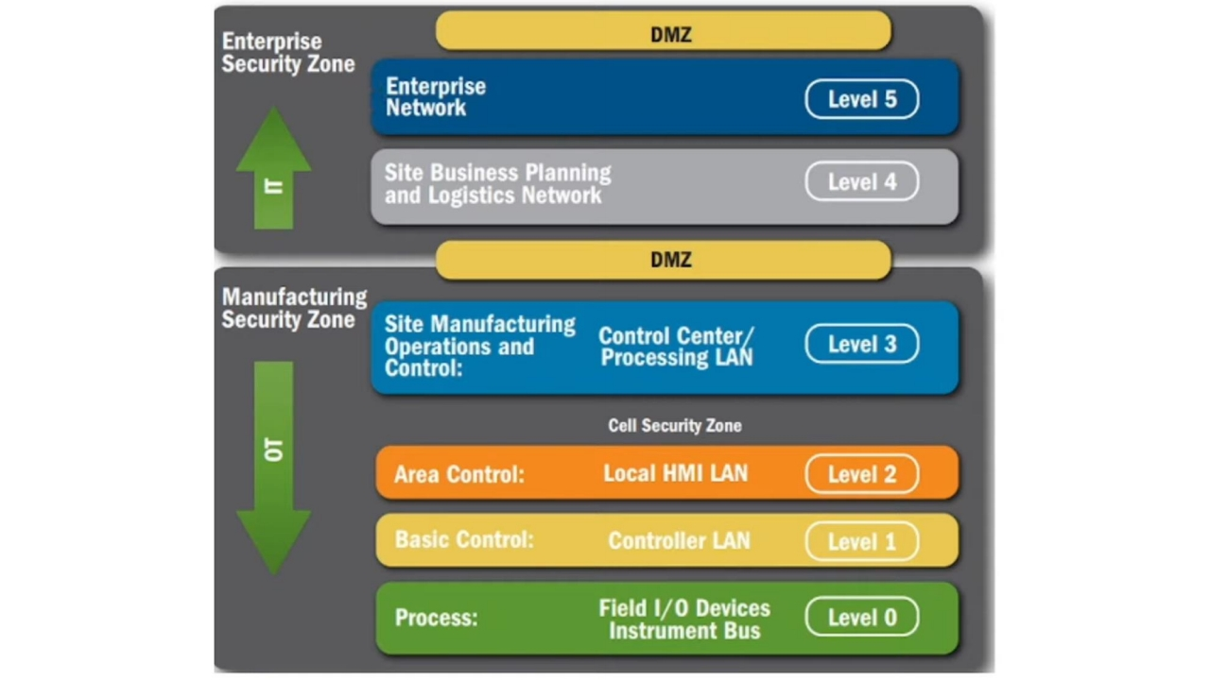

Slide 17
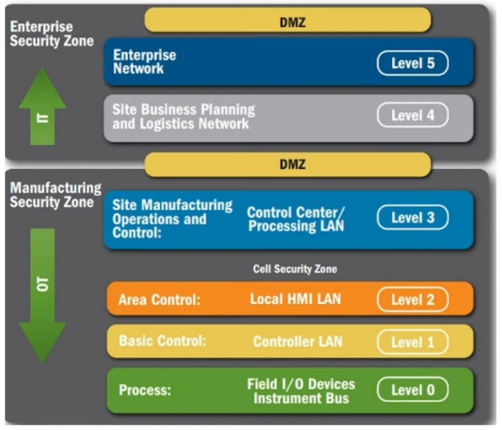
ICS Network Architectures
Adopting this recommended architecture design provides heightened security and a clear visual representation for both designers and engineers. It facilitates the implementation of multiple layers of cybersecurity, ensuring robust protection
while accommodating various technology
components and interconnections.

Slide 18
IT integration into control systems brings security challenges and increased attack surface.
Factors like automation reliance, connectivity, vulnerable tech, and control system limitations contribute to issues.
Wrap
Up
Solutions: recommended architectures, clear zones, network segmentation, and DMZs.
Enhancing control system security requires staying informed, implementing robust measures, and constant improvement.

